Slide 1

Staying Above A Rising
Security waterline.
(through software engineering)
Evan Johnson
Notes:
This talk is called staying above a rising security waterline
And it’s really about, at a very high level, some things that might not be normal that I focus on at work to limit future foot shooting by our engineers, and some cool things that this has led too.
On my way over here I was thinking about this and what the talk is really about is double-whammys and winning. How I started selling security stuff to upper management by finding other people that benefits from the security work.
Instead of trying to add on security at the end, which everyone knows doesn’t work, we are focused on building high quality software with security being a byproduct of a strong software development lifecycle.
This is important because it scales a lot better in startup world.

Slide 2
whoami
Evan Johnson.
Work at CloudFlare on all things security.
Worked at LastPass previously
4th time attending RVASec. 1st Time speaking
JMU Double Duke. Graduated in 2014.
Notes:
Evan Johnson.
I work at cloudflare out in san francisco and in the past I’ve worked doing some independent work and I worked at lastpass the password manager in fairfax.
4th time attending RVASec. 1st Time speaking
JMU Double Duke. Graduated in 2014.

Slide 3
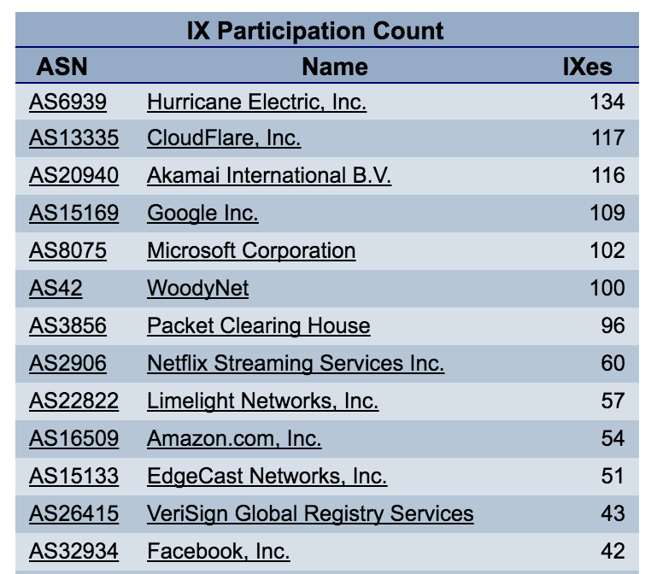
What Is CloudFlare
Notes:
CloudFlare runs one of the largest and most well connected networks in the world.
We are a giant HTTP reverse proxy and Content Delivery Network that proxies billions upon billions upon billions of requests.
What does this mean in english? Customers sign up for our web service and our service sits as a man in the middle to their
We have a lot of really neat features like a caching layer, a WAF, IP Firewall, that makes customers attracted to us.
Being a reverse proxy it means we handle all of our customers requests at our 80ish datacenters. We handle an astronomical number of HTTP requests.
Our mission is to make the web faster and more secure for everybody

Slide 4
Why is security important to us?
Basically, what secret assets do we have?
Customer SSL keys
Reliability of millions of sites
Customer Origin IP addresses
Customer Settings
API Keys
Internal Secrets
Notes:
To answer why security is important you have to know what you are protecting. Everyone has secrets or requirements. We have:
We give away SSL for free. We call it universal SSL, but we do NOT want the keys leaking. This would obviously be awful. Losing trust
We have agreements with our customers about our reliability. Since we are a giant HTTP proxy, If someone can disrupt our service that’s very bad for business
Some people disagree with the ideology of our customers and want to silence them through DoS attacks. We hide their IP addresses. We consider these “secret”
Customers might hide things they don’t want exposed to the public with settings
Customers have API keys
We have secrets in our business. Internal auth keys. Internal CA. We care about these

Slide 5

What… do I do?
Notes:
What I look out for at my job
My job is to make our software and user security at cloudflare better and more secure. When I first joined they wanted me to hunt and perform audits all the time to find security bugs, and I just didn’t do that. It wasn’t a very good use of anybody’s time having other people write the code and having me reading their code….I’m lucky enough to work with really really really talented engineers and other security experts whose job is not security our engineers are the biggest bug reporters.
A lot of time triaging security bugs. I write code to fix the bug but then after I triage the bug if it’s something that could be widespread you need to squash the bug class.
My goal is to make it so nobody ever has to think about these bugs that get found, they are just mitigated for everybody
One of the main themes of this talk is that the security is directly related to your software quality principles. The same things that make software good are what makes software secure
And to start making software more secure we have to talk about what software even looks like this day and age. What are people doing?
The answer is a lot of new tools and new stuff is hitting production, and everyone even really really big companies and banks are adopting agility and

Slide 6
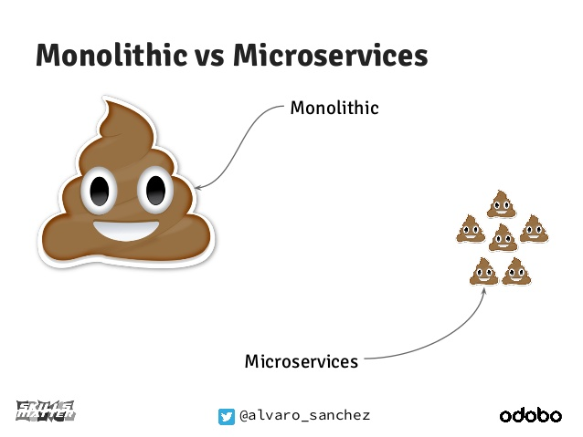
Microservices
Notes:
We do a “microservice” thing for all of our internal services and pretty much everything is the same stack.
A Microservice architecture is when you split up your service in to a lot of smaller, simpler services. It’s very popular to do right now because technologies like docker has made it much more popular and easy to do. It’s also made it much easier to deploy these services in to production things like kubernetes
Going to talk about “docker” and “containers” as well. If you’re not familiar with these terms, docker is just a tool
Microservices done wrong are a big pain operationally
From a security perspective this is a new challenge.
Do you perform application security reviews of each small service?
How do you approach this?
How do you fix a bug or know where other bugs live?

Slide 7
Microservices done wrong look like .
You found a vuln but which others have it?
How do you handle circular dependencies?
How do you handle high latency?
Are you equipped to trace operational issues?
If your service breaks, downstream services have to be ready.
If someone quits, can you operate services they owned?
Notes:
Slide has general problems that need to be solved for microservices.
If you choose to go microservices and you aren’t ready then you’re going to have a bad time.
There are so many new failure cases and operational issues to conquer.
Helping to solve these issues happens BEFORE the service is alive
Microservices are a trade off. Much higher operational complexity in exchange for lower code complexity
If you aren’t ready for this, it means that your core services, for example a “string concatenation” can take down your whole system! Be careful.

Slide 8
Microservice “Standard”
All services look the same.
All written in Go
All have a dockerfile
All have a makefile
Notes:
We do a “microservice” thing for all of our internal services.
Having this makes security people happy! Having this makes software and operations people happy!
Having a “standardized structure” for what projects and services look like is a must have.
If you’re not in a microservice architecture, having strong style guidelines, having strong module guidelines is very important.
Allows anyone writing code at the company to spin projects up and give them a try.
Great software engineering principle. Most dev shops have a “programming style guide” so there should naturally be a “microservice style guide”
What does this mean for infosec?
Without a standard way to approach an audit, you have to learn the environment of every single project that ends up in front of me
End up not needing to ask a ton of questions. Needing to figure out all the crazy ways people set their projects up. Lots of things become “self documenting”
This is a huge huge huge relief of friction to me. “Hey Evan I have X Project”, “hey I’ll spin it up and poke it!”
This is absolutely a must have
Tons and tons of code re-use. We have a small set of libraries that are reused everywhere. This cuts down on audit time when infosec is familiar with the libraries already.
Infosec can then focus on new functionality. Architectural issues that we forsee.
If you don’t do this, you are putting hurdles in front of your security team. Their job is not to rebuild your dev environment to test your service. It’s to provide security expertise. Having required standards enables the security team to get to a point where they can provide security expertise. It’s that simple.

Slide 9
Secure Interfaces
Secure interfaces are APIs that are designed to help developers make fewer mistakes.
Let us take a look at some interfaces and you tell me.
Notes:
Secure interfaces are another huge thing that helps keep our organization ticking
I like using them to hide complicated things from users.
The reason all of these application security companies exist is because some software developers have specialized knowledge that others do not.
Used to:
Provide secure by default APIs to users.
Abstract away hard things that people are likely to mess up
It’s hard to define the properties of a “secure interface”. You really have to sit there and think about how each parameter to a system could be misunderstood, and help users by making opinionated and safe-by-default choices.

Slide 10
Secure Interfaces
char *strcpy(char * dst, const char * src);
char *strncpy(char * dst, const char * src, size_t len);
strlcpy is good but can we do better?
Notes:
Are these secure interfaces?
These are infamous.
Strcpy is the pinnacle of awful interfaces. Strcpy has a long and storied infosec career.
Strncpy exists too. Lots of people will recommend using strncpy instead but it still lets you shoot yourself in the foot!
These are bad interfaces! They make buffer overruns happen!
Now, you may not want a secure interface for copying strings, but If I had my own secure interface for copying strings I would remove all this complicated stuff from the picture. No worrying about null terminators, no worrying about string sizes. Some ideas?

Slide 11
Secure Interfaces, Improving strcpy
char *strcpy(const char * src);
Notes:
What about this? I would love feedback if you’re a C guru. Take a source and it gives you a new pointer.

Slide 12
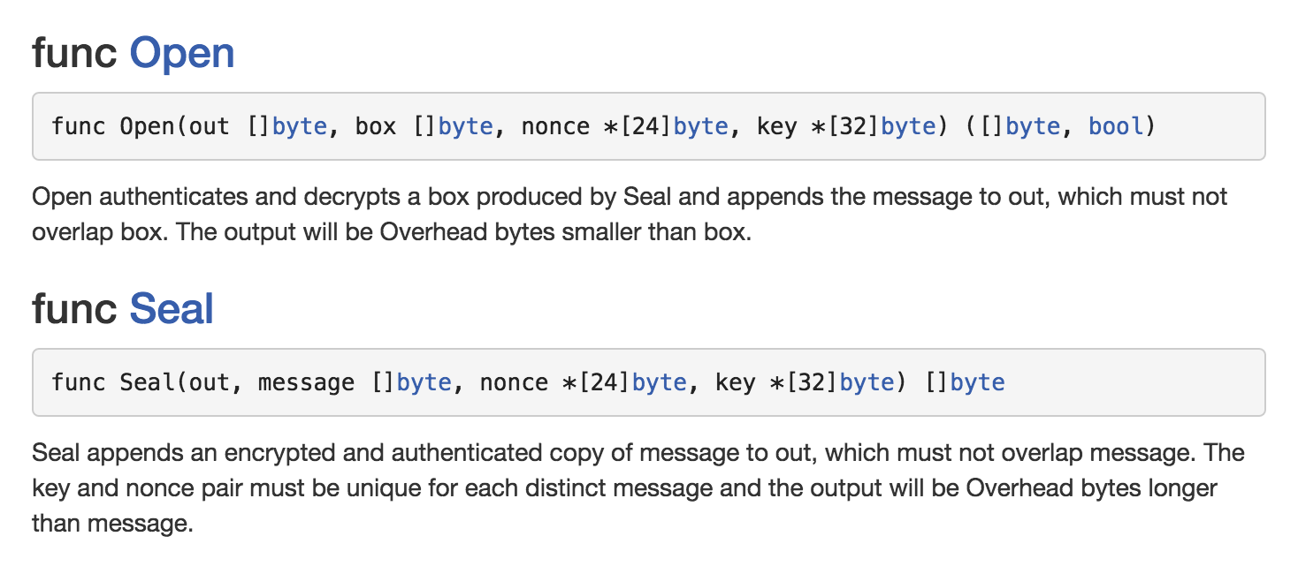
A Good Secure Interface
Notes:
This is the AEAD interface. Open and Seal
AEAD’s have abstracted away the details of performing basic cryptographic operations. Encrypt and decrypt are replaced with seal and open.
Instead of having to figure out “initialization vectors” or which cipher mode you need you only need to call Seal and Open and the AEAD takes care of the rest performing secure authenticated encryption.
The only issue with AEAD’s is nonce reuse is possible. I abstracted this out so a random nonce is generated. Lots of people do this and it provides a really safe and secure method of encrypting and decrypting that non-cryptographer devs can do.
Since we write all our projects in Go, everyone can use this code easily with only a few extra lines of code.
This is a monumental step forward for cryptography everywhere and if your devs write crypto code, you should let them know that using the letters “AES” probably means they are doing it the wrong way.
Using this interface is great because, like I said earlier, it scales. Hundreds of devs using this does not scare me. Hundreds of devs trying to encrypt and authenticate something using AES really really scares me. I’ve seen so many crazy and incorrect ways to use AES it’s appalling. Tons of them would go away if the developers just used an AEAD instead.

Slide 13
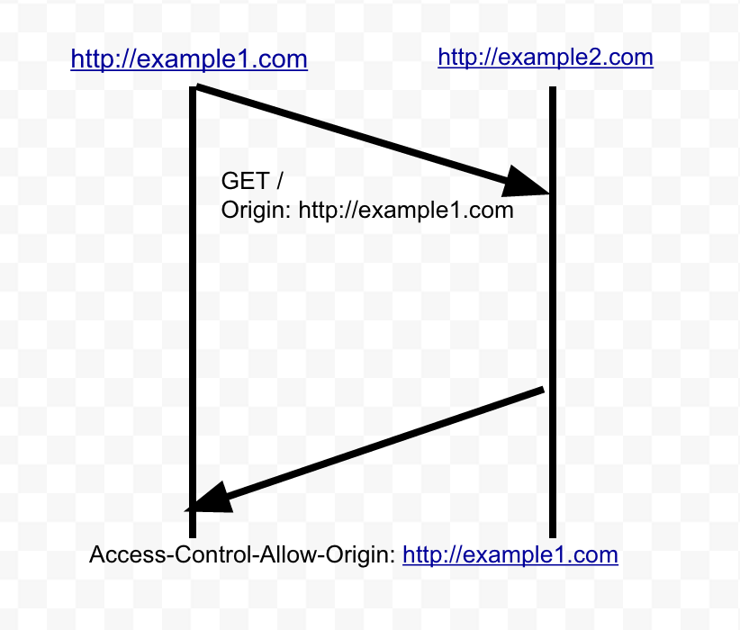
CORS Success Story of many secure interfaces
CORS is a policy for whitelisting and scoping cross origin requests.
Notes:
So here’s a nitty gritty technical story or a success story.
Explain the details of SAMEORIGINPOLICY and what it means for web requests.
Explain that one website can not request data or post data to others without CORS.
SAMEORIGIN policy is the glue that holds web security together. CORS provides a way to poke holes in SAMEORIGN policy. Except it’s really important to understand the holes you’re poking.
All driven by origin header which is something that browsers send every request.

Slide 14
CORS Issue
One day I was examining some code and noticed there was a problem with an internal application.
Not just slightly misconfigured. It was REALLY misconfigured, but the difference was very small.
Notes:
CORS was misconfigured and worse yet, the code that was meant to provide CORS in a sane way to applications that needed it was not well written and certifiably insane.
This meant that any site could make cross origin requests to internal applications.
CORS headers were misconfigured to break SAMEORIGIN policy on the site, the glue that holds all of internet security together.

Slide 15
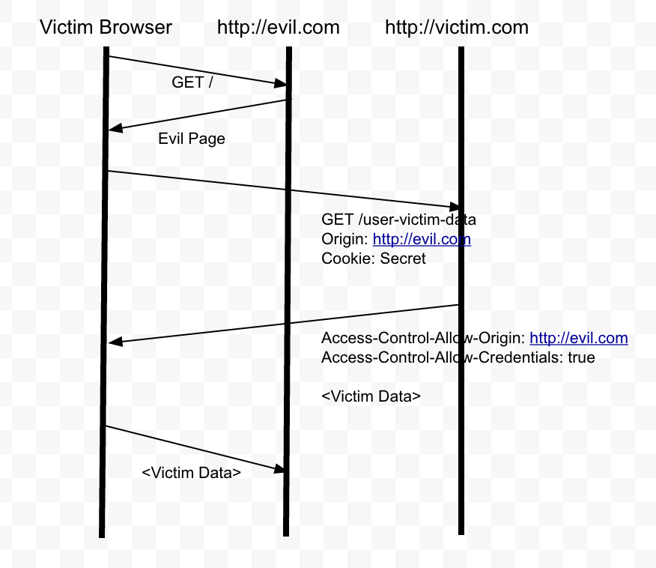
CORS Attack
Notes:
This is how the CORS attack would work.

Slide 16
CORS Remediation
I wrote code to fix this internally for everyone
The impact of this bug both shows the need for secure interfaces and the impact of making security critical things without a secure interface.
Notes:
Wrote a secure interface around this.
No reflecting origin blindly. Small whitelist. Much easier to maintain
The sentence on the page CORS Issue shows perfectly why a secure interface is needed.
This got me thinking though. I think the engineer who built this vulnerable code is really good. If he made a mistake I’m sure a lot of other people made a similar mistake.

Slide 17
CORS Bug Scope
Massive impact on the open web. Sites vulnerable have basically disabled the glue that holds all web security together.
I scanned the alexa top 1 million and about 1000 were vulnerable.
Notes:
So...it had a massive impact and still has a massive impact.
This bug basically completely disables a hugely important part of SAMEORIGIN policy.
Wrote proof of concept code that stole bitcoin, credit card numbers, healthcare info etc.
The worst part is this isn’t a bug in any one library or any one framework. It’s developers misunderstanding an RFC. This is really challenging to fix. You can’t get a CVE for it. You can add it to web vulnerability scanners but it won’t do much good.
At CloudFlare, I can fix this. I can’t fix it for misconfigured customers. I can’t fix it for the whole internet by sending in a pull request in an open source project somewhere. It’s really difficult thing to fix.

Slide 18
Conclusion
Apply good software engineering practices to security sensitive projects. The outcome is a huge leap forward in security.
Any questions?
@ejcx_, https://ejj.io, evan@cloudflare.com
Notes:
Solving the core problem
Security, even in the SaaS industry is still a people problem.
Coordination and communication and maturity are important.
Lots of times, groups and teams end up having the same issues. Security bugs, road-blocks and don’t even realize it, and it may manifest itself as a security issue. If you’re on a gig and you notice one or two issues are rampant everywhere, there may be a bigger issue
Recognize this!
Knock the road-blocks down together through software engineering and security

